Slide 2
Conflicts of Interest
Nothing to disclose

Slide 3
HIV Remission Trials:
Correlates of Rebound
Carlo Sacdalan, MD, MBA
Clinical Research Physician
SEARCH, The Thai Red Cross AIDS Research Centre
carlo.s@searchthailand.org
Share your thoughts on this presentation with #IAS2019

Slide 4
Outline
  HIV remission trials overview
  HIV remission trials –results
      RV411
      RV409
      RV397
      RV405
  Factors associated with rebound during ATI

Slide 5
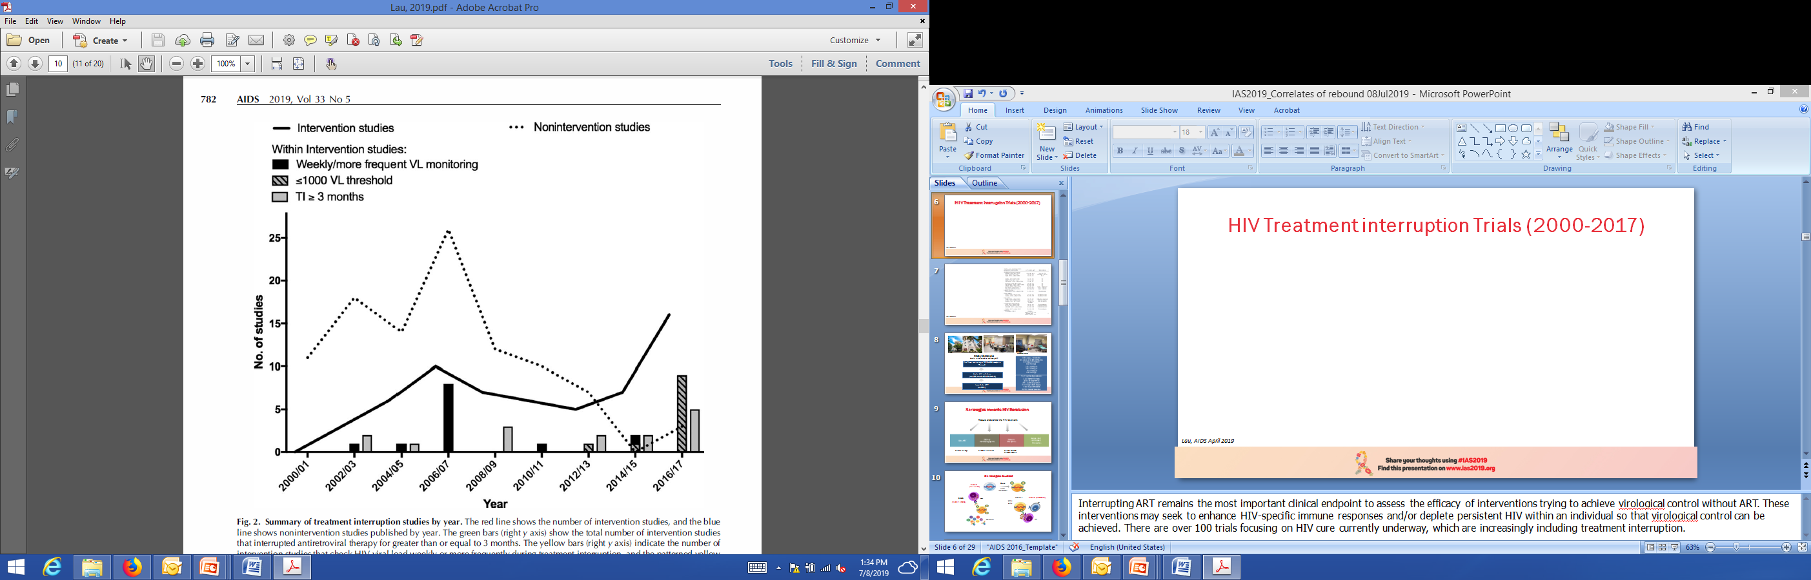
HIV Treatment interruption Trials (2000-2017)
100
Nonintervention studies
59
Intervention studies
Lau, AIDS April 2019

Slide 6
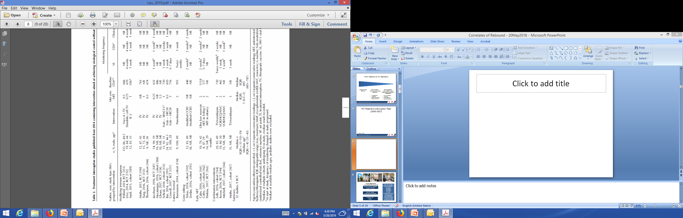
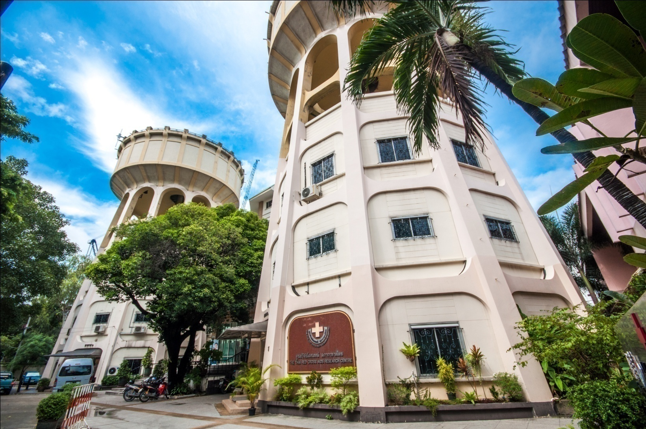
HIV Treatment interruption trials with intervention done from 2014 to 2017
22
4*
Trials done at Thai Red Cross AIDS Research Centre
* Plus RV405 study presented in Keystone Symposia 2019
Lau, AIDS April 2019

Slide 7
RV254 and HIV Remission Trials
RV254/SEARCH010
Acute infection cohort with early ART
Early ART in Fiebig I
RV411 (n=8)
Fiebig I
ATI, Single arm
Real-time screening of 343,663 samples in Thailand
Remission
trials
Latency Reversal
RV409 (n=15)
Fiebig III/IV
VHM+ART (n=9) vs. ART (n=5)
Acute HIV infection
(n=614 enrolled/781 detected)
Monitoring
VL q3-7 days
ART resumption
VL > 1000 copies
Outcomes
Safety
VL control
24 weeks post ATI
RV397 (n=18)
Fiebig I to III
VRC01 (n=13) vs. placebo (n=5)
Modifying Immune Response
Immediate ART
(n=609)
RV405 (n=27)
Fiebig I to IV
Ad26/MVA (n=18) vs. placebo (n=9)
ATI: analytical treatment interruption
VHM: vorinostat+hydroxychloroquine+maraviroc

Slide 8
Analytic treatment interruption studies from the RV254 cohort (n=67)
Acute
infection
On ART
Stop ART/
monitor rebound
n=8 Fiebig I
No
Intervention
N=27
RV411
Vorinostat
n=9 Fiebig III/IV
hydroxychoroquine + maraviroc
RV409
n=5 Fiebig III
Control
Intervention
pre-ATI
N= 27
VRC01
n=13 Fiebig I-III
RV397
n=5 Fiebig II/III
Placebo
Intervention
post-ATI
N= 13
Ad26
MVA
n=18 Fiebig II-IV
RV405
n=9 Fiebig I-III
Placebo
Kroon, IAS, 2016; Colby, Nature Medicine, 2018; Crowell, Lancet HIV 2019, Slide courtesy of Nicolas Chomont

Slide 9
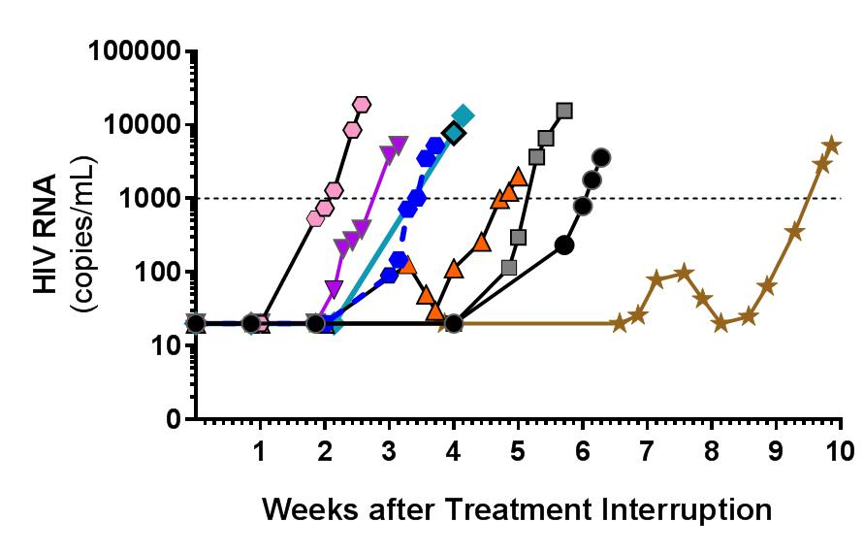
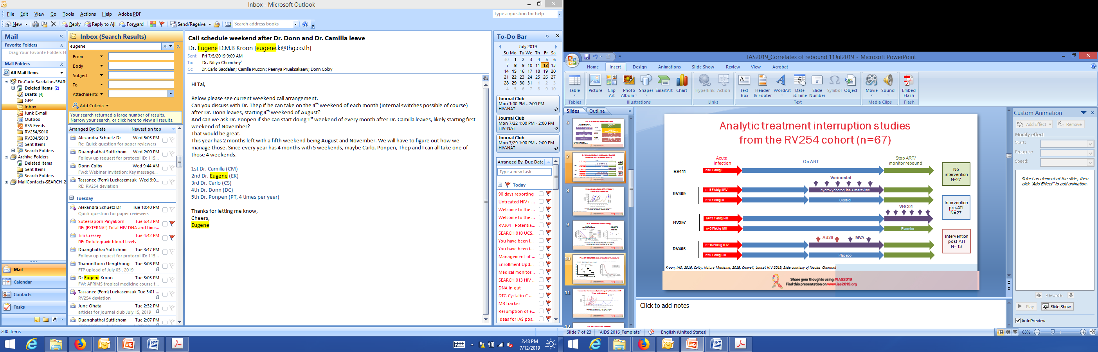
RV411: Early ART in Fiebig I
ART resume at
VL > 1000 c/ml
Median time to viral load rebound >20 copies/ml: 26 days (range 13-48 days)
Very early ART alone is inadequate to achieve HIV remission
Colby, Ananworanich, Nature Medicine 2018
Intervention: Early ART in Fiebig I

Slide 10
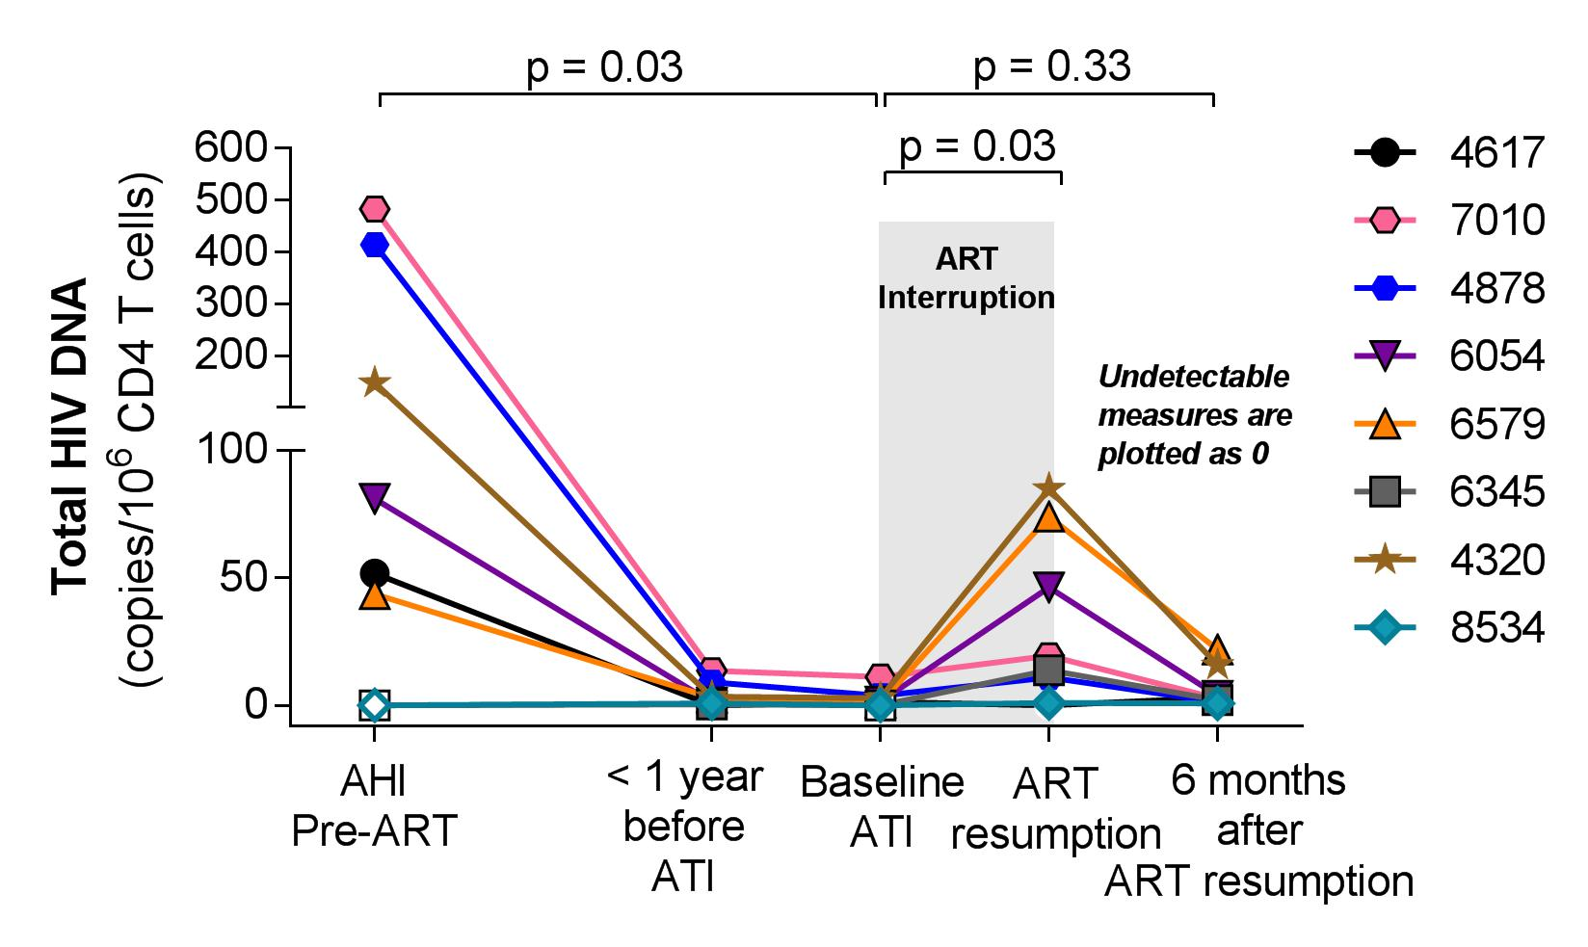
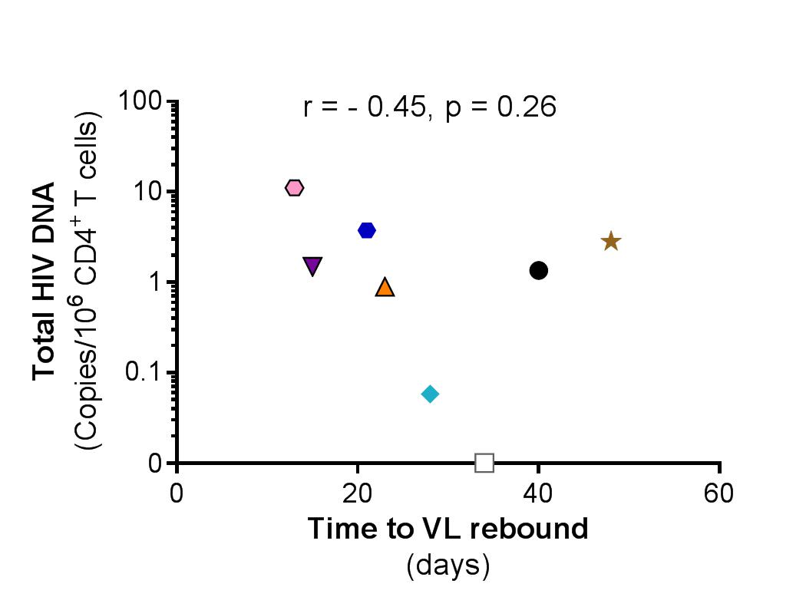
HIV Reservoir Size in Fiebig I
Total HIV DNA in CD4
From pre-ART to ATI to ART resumption
Pre-ATI total HIV DNA
(median 1 copy/10⁶CD4)
vs.
Time to VL rebound
Reservoir size (total HIV DNA in CD4) at VL rebound - smaller than at acute infection
Pre-ATI HIV DNA was not significantly associated with time to VL rebound
Leyre, Pagliuzza Chomont (U Montreal)
Intervention: Early ART in Fiebig I

Slide 11
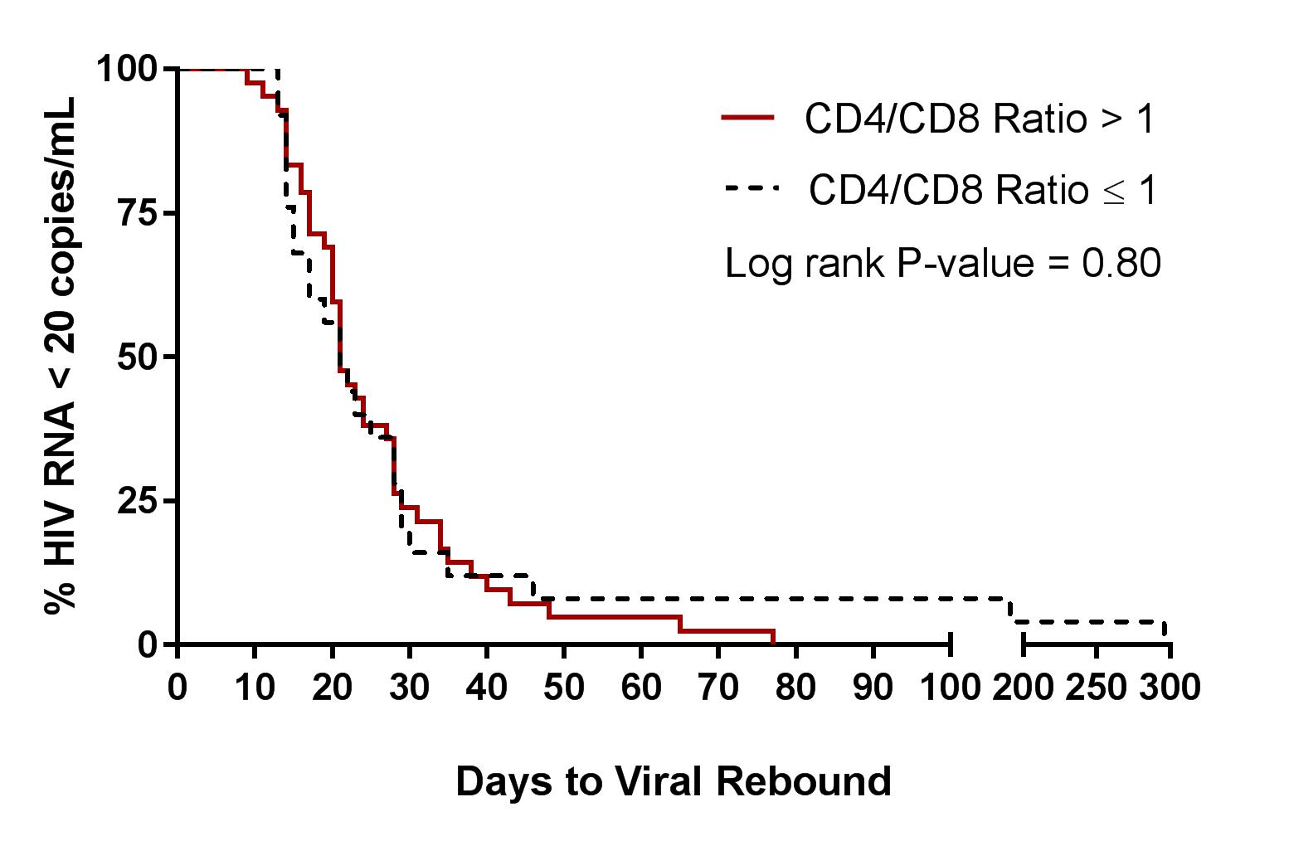
Pre-ATI CD4/CD8 ratio and time to VL rebound
RV411: CD4/CD8 ratio ≤ 1 faster rebound
All studies, (n = 67): no difference
p=0.004
n=3
n=5
Colby, Ananworanich, Nature Medicine, 2018
Intervention: Early ART in Fiebig I

Slide 12
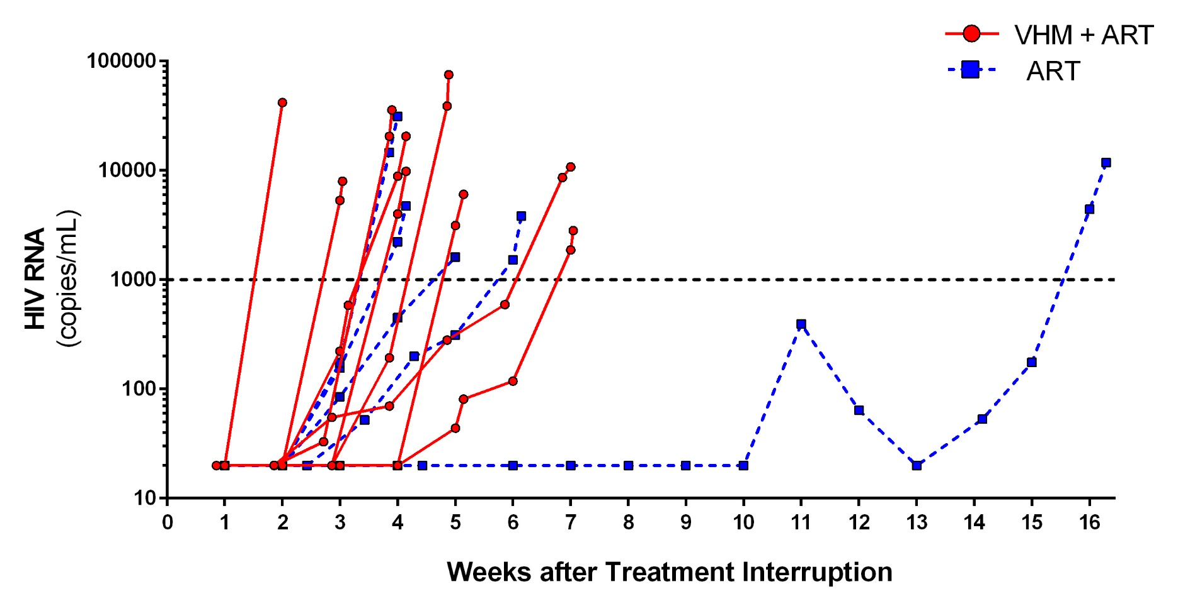
RV409: Vorinostat, HCQ, Maraviroc (VHM) +ART vs ART
ART resume at
VL > 1000 c/ml
Median time to first VL detection: 22 days (range 14 to 77 days)
No difference between active and non active study arms
Kroon, de Souza, IAS 2016 (manuscript submitted)
Intervention: Vorinostat

Slide 13
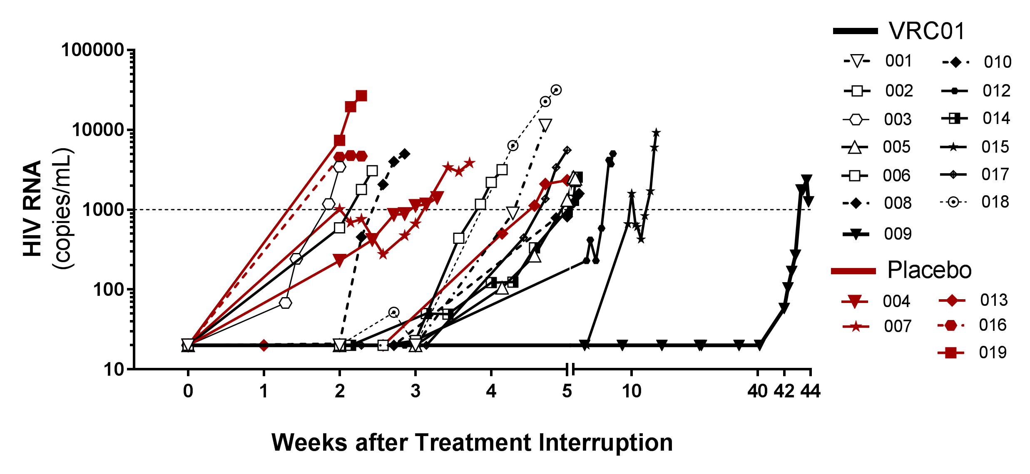
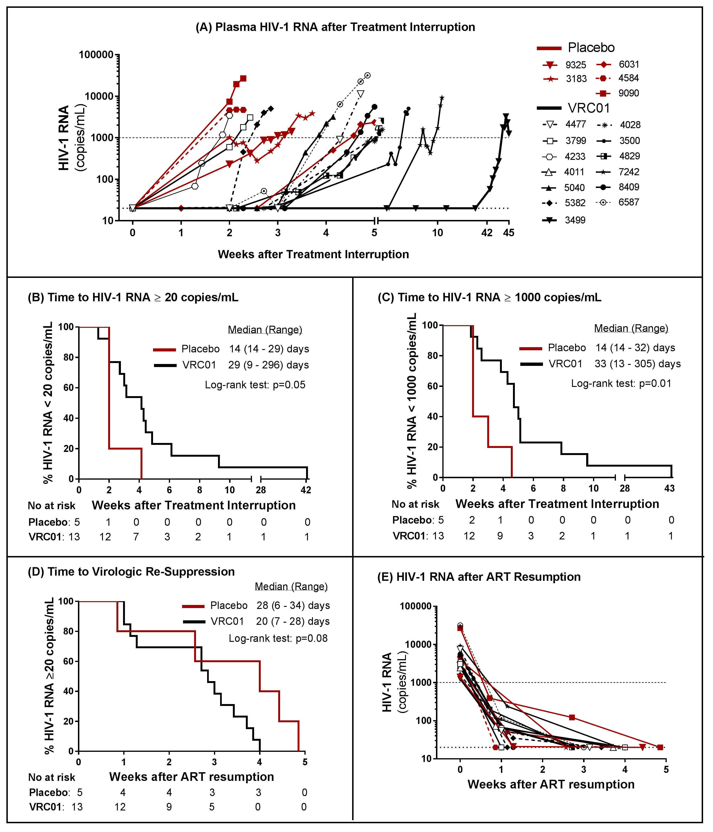
RV397: VRC01 vs Placebo
Trend toward delayed virologic rebound with VRC01 in people suppressed during acute HIV infection
Potential for improved response with better and multiple bNAbs
Crowell, Colby, Ananworanich, 2017 IAS
Intervention: VRC01 vs Placebo

Slide 14
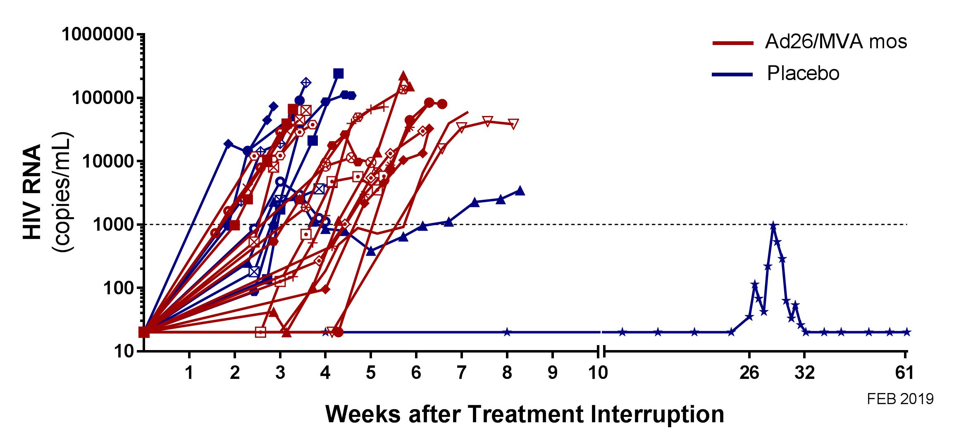
RV405: Ad26/MVA vs Placebo
 | Ad26/MVA | Placebo | P Value
Time to VL >20 copies/mL | 23 days (11-46) | 17 days (13-182) | P=0.26
Time to VL >1000 copies/mL | 26 days (13-46) | 21 days (13-252) | P=0.36
ART resume at
VL > 1000 c/ml
Median time to VL > 20 copies/ml for all participants: 20 (11-182) days
No acute retroviral syndrome or new resistance mutations
Post-treatment controller was HLA B5701+¹
25 of 26 participants resumed ART and had VL suppression by median of 28 (IQR 19-33) days
Colby, Ananworanich, Keystone Symposium (X8), 2019
Intervention: Ad26/MVA vs Placebo

Slide 15
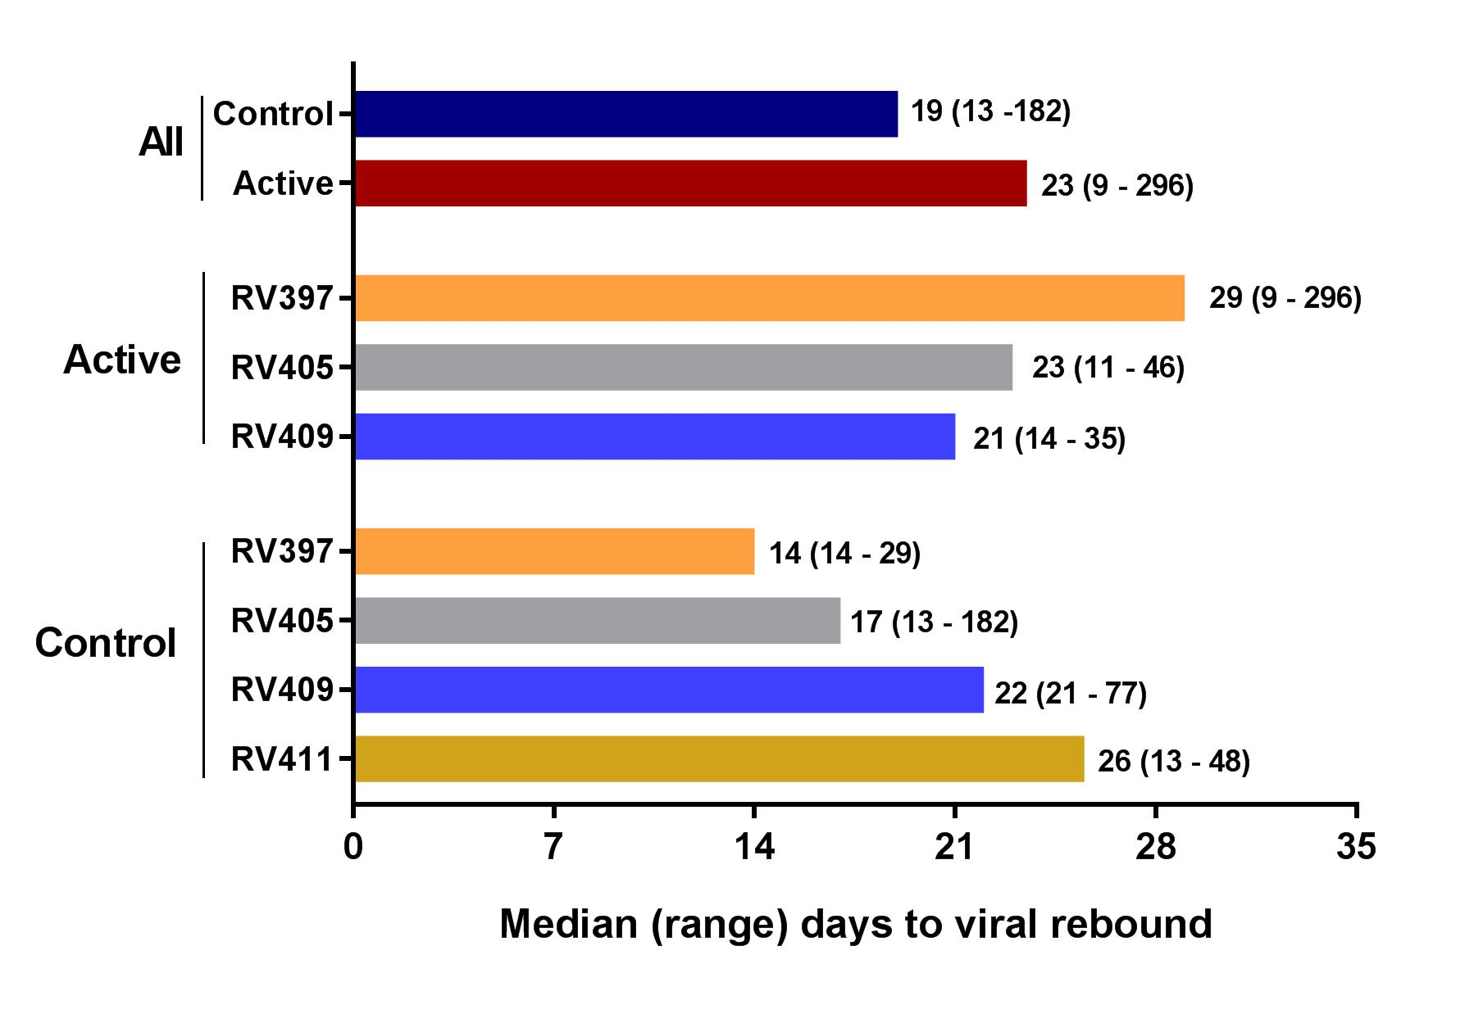
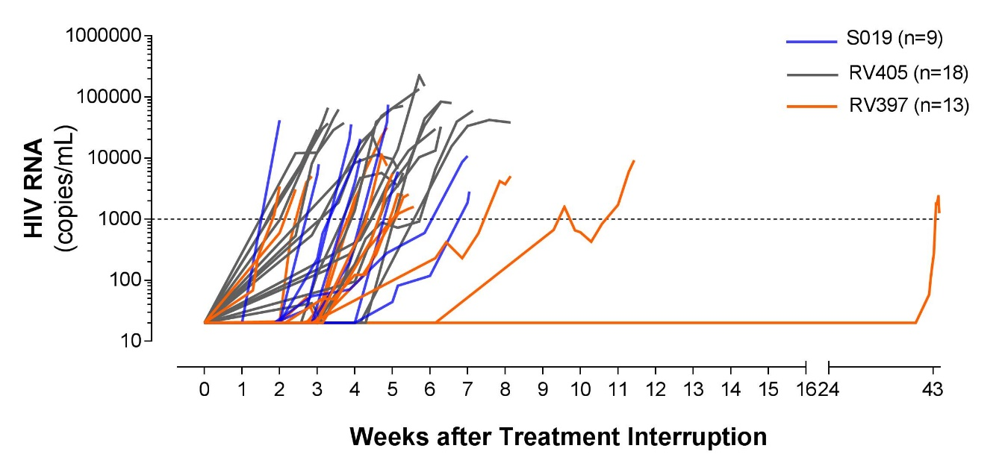
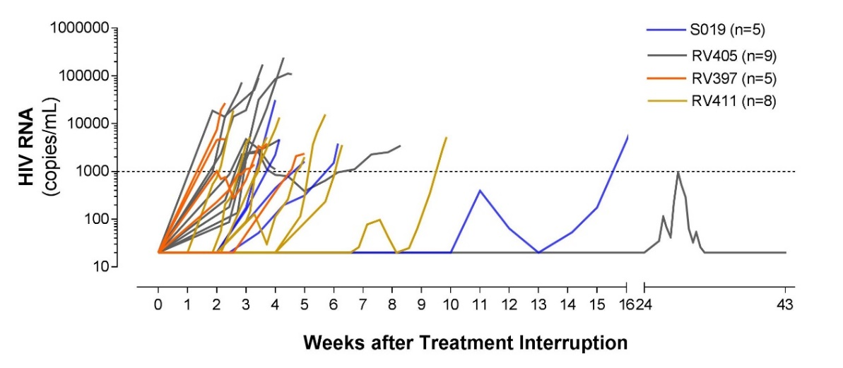
All ATI studies: Time to viral rebound (n=66)
Treatment
RV397: VRC01
RV405: Ad26/MVA
RV409: Vorinostat
RV411: Fiebig I
Placebo
Log-rank
P> 0.05 for all
Safety:
No acute retroviral syndrome
No new resistance to all ART classes post ATI
All who resumed ART had VL suppression within 28 days
Colby, Ananworanich, Nature Medicine, 2018
Crowell, Lancet HIV , 2019
Kroon, de Souza, IAS, 2016

Slide 16
Factors associated with time to viral rebound during ATI:
Days to >20 copies/mL

Slide 17
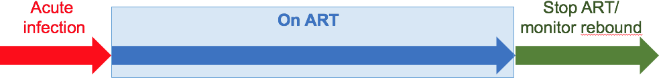
Total HIV DNA pre-ART (acute infection) and time to rebound (n=66)
*DNA
HIV DNA pre-ART does not predict time to rebound to >20 copies/mL
Slide courtesy of Diane Bolton (MHRP) and Nicholas Chomont (U Montreal)

Slide 18
Total HIV DNA pre-ATI and time to rebound (n=66)
DNA*
HIV DNA pre-ATI does not predict time to rebound to >20 copies/mL
Slide courtesy of Diane Bolton (MHRP) and Nicholas Chomont (U Montreal)

Slide 19
pVL pre-ART (acute infection) and time to rebound (n=66)
*pVL
0.1
0.4
0.06
0.04
0.6
Time to pVL >1000 copies/ml
(rho)
0.05
0.2
0.03
0.01 (-0.31)
0.4
Unless all participants are analyzed together, pre-ART VL does not predict time to rebound to >20 copies/mL
Pre-ART VL is modestly associated with time to rebound to >1,000 copies/mL
Slide courtesy of Diane Bolton (MHRP) and Nicholas Chomont (U Montreal)

Slide 20
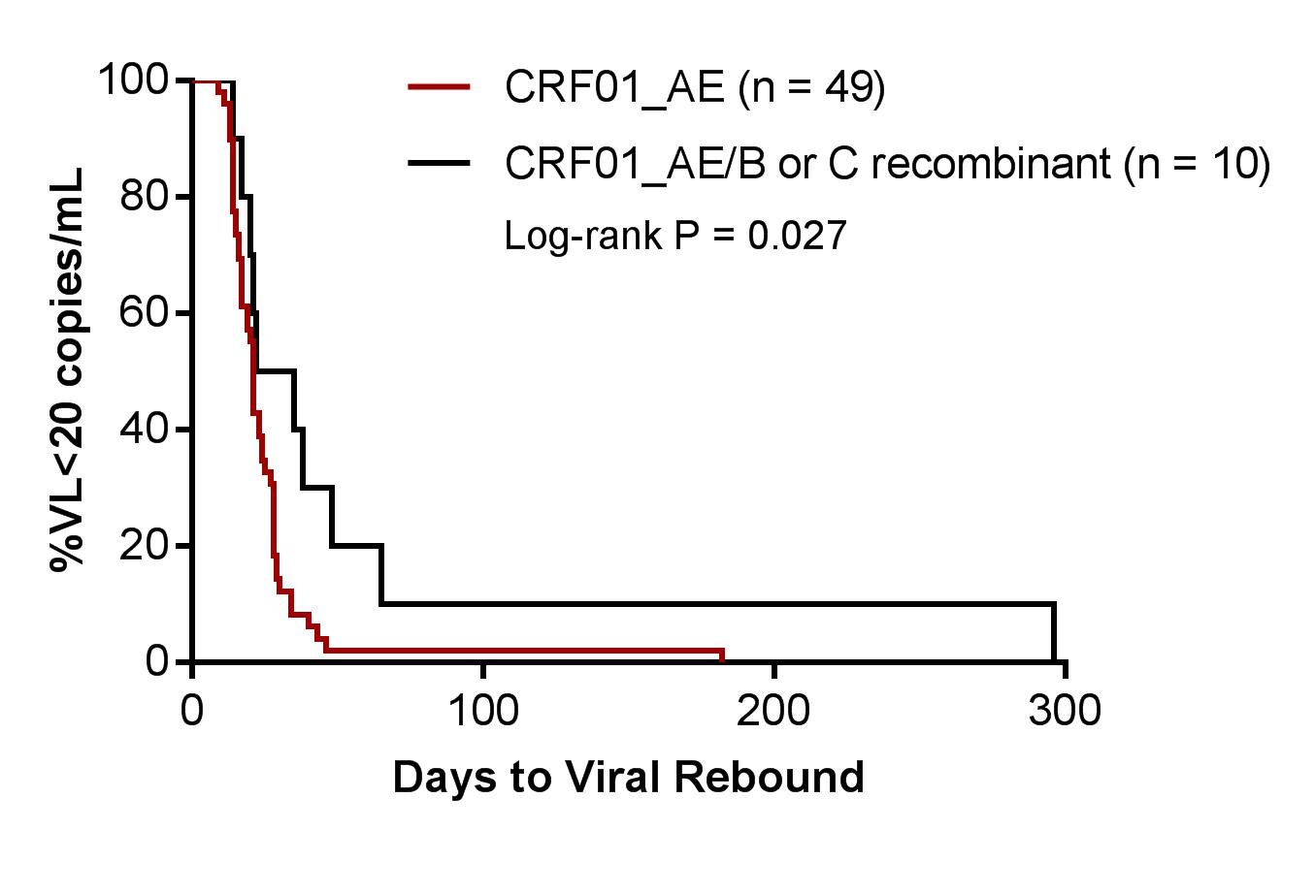
CRF01 _AE associated with time to viral rebound
HIV subtype and time to rebound
Variables tested that do not impact time to rebound:
Sex
Age
CD4-pre ART, pre-ATI
CD8-pre ART, pre-ATI
CD4/CD8 ratio -pre ART, pre-ATI
HIV RNA pre-ART
Total HIV DNA pre-ATI
CRF01_AE was associated with faster time to viral rebound
Slide courtesy of Donn Colby (SEARCH, The Thai Red Cross AIDS Research Centre)

Slide 21
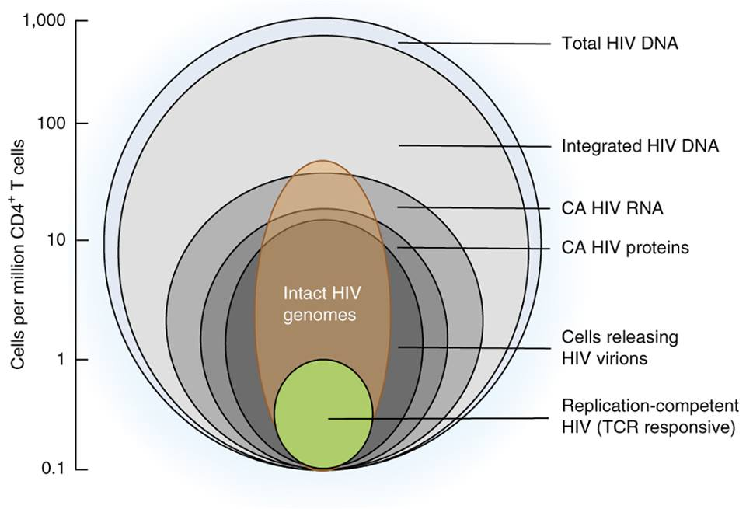
What predicts viral rebound after treatment interruption?
Sneller, 2017
Williams, 2014, (SPARTAC)
Assoumou, 2015 (ANRS 116)
Li, 2014 (ACTG A5197)
Li, 2016 (ACTG pooled ATI studies)
Sneller, 2017
Sneller, 2017
Image from defeatHIV

Slide 22
HIV Remission Trials: Where are we?
HIV Remission Trials
Treatment interruption with intervention becoming more frequent
Heterogeneity in design
Studies inform efficacy/ safety of interventions and future trial design
Predictors of rebound may accelerate therapeutics development

Slide 23






MHRP
Jintanat Ananworanich
Sandhya Vasan
Nelson Michael
Merlin Robb
Julie Ake
Trevor Crowell
Sodsai Tovanabutra
Linda Jagodzinski
Lydie Trautmann
Diane Bolton
Shelly Krebs
Bonnie Slike
Michael Eller
Leigh Ann Eller
Morgane Rolland
Rasmi Thomas
Suteera Pinyakorn
Supranee Buranapraditkun
Tsedal Mebrahtu
Maddy Ouellette
Oratai Butterworth
Ellen Turk
Case Western
Rafick Sekaly
Drexel
Elias Haddad
RTI International
Holly Peay
UT Houston
Netanya Sandler
AFRIMS
Robert O’ Connell
Denise Hsu
Rapee Trichavaroj
Bessara Nantapinit
Siriwat Akapirak
U Montréal
Nicolas Chomont
Remi Fromentin
UCSF
Victor Valcour
Joanna Hellmuth
Yale
Serena Spudich
NIH
Irini Sereti
Daniel Douek
Eli Bortiz
Frank Maldarelli
Leidos-NCI Frederick
Claire Deleage
Robert Gorelick
Michael Piatak
Robin Dewar
Adam Rupert
U Minnesota
Tim Schacker
UNC
Gail Henderson
Jean Cadigan
Thai Red Cross
Praphan Phanuphak
Nittaya Phanuphak
Nipat Teeratakulpisarn
Mark de Souza
James Fletcher
Eugene Kroon
Donn Colby
Phillip Chan
Nitiya Chomchey
Jintana Intasan
Tippawan Pankam
Sasiwimol Ubolyam
Chulalongkorn University
Kiat Ruxrungtham
Rungsun Rerknimitr
Sukalya Lerdlum
Netsiri Dumrongpisutkul
Mantana Pothisri
Phandee Wattanaboonyongcharoen
Ponlapat Rojnuckarin
Sopark Manasnayakorn
Sunee Sirivichayakul
OHSU
Jacob Estes
U Hawaii
Lishomwa Ndhlovu
Industry
Thai Gov Pharm Organization
ViiV Healthcare
Gilead
Merck
Acknowledgements
The study participants

